Slide 1
CT052-3-3-INV
Nur Amira Abdul Majid
FYP Manager – CS,CS(DA), CS(AI)
nuramira@apu.edu.my
Monday – Friday, 10AM – 5PM
Seating Location: Staff Room, SOC, Level 5, APU

Slide 2
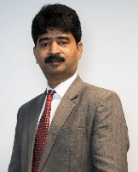

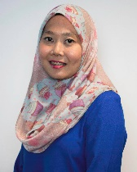
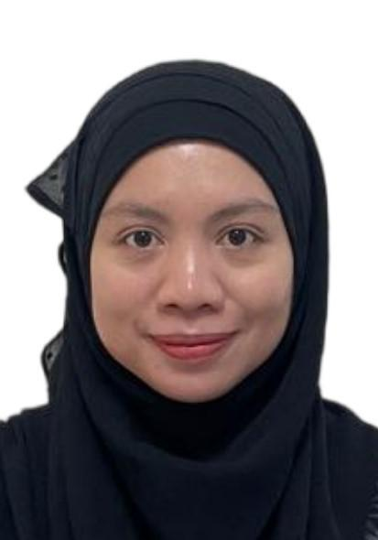
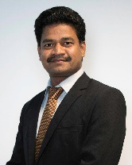
FYP Managers
  Mr. Dhason Padma Kumar (Main) – focusing on Software Engineering (SE) projects.
  Ms. Nur Amira – focusing on CS, CS(AI), CS(DA) projects.
  Ms. Rizawati Rohizan – focusing on MMT, CGD and MMT(VRAR) projects.
  Ms. Raja Norliana – focusing on IT,IT(BIS),IT(IOT),IT(MBT),IT(CC),IT(FT),IT(DT),IT(CE),IT(CC) and IT(NC) projects.
  Ts. Mr. Umapathy Eaganathan – focusing on CS(CYB), CS(FD) and IT(ISS) projects.

Slide 3
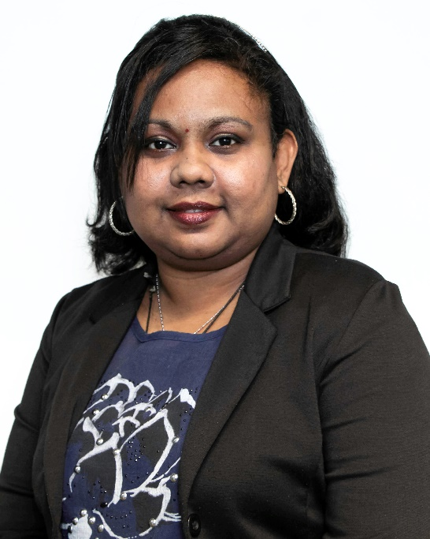
FYP Administrative Staff
Miss Jonas David Yassu is your FYP administrator staff.
Email address: jonas.david@apu.edu.my
Office location: Level 4, Admin office, Block D
Important notes: If the student needs any letter for the purposes of data gathering (if it is requested by the organization/company), please send an email to admin front liner fliners@apu.edu.my for it.

Slide 4
Learning Outcomes
At the end of today’s session, YOU should be able to :-
Understand the purpose of a project.
Recognise the project processes and timelines.
Identify the key elements in project assessment and modules.
Identify the people involved throughout the final year project.

Slide 5
Elements of Project Assessment and Modules
(APU-FYP)
Project Proposal Form (PPF)
Ethics Form)
Investigation Report (IR)
Design, Coding and Testing
FYP Submission and Presentation
100%(semester 1)
200%(SEMESTER 2)

Slide 6
FYP Process
Commencement
of Level 3
Supervisors Appointed
Supervisor
Clinic
Schedule Meetings & Meeting logsheets submit to FYPBank system
Ethics Form (submission to FYPBank system)
Submit Investigation Report (IR)
and 3 Meeting logsheets
(Moodle submission for IR)
Submit Project Proposal (submission to FYPBank system)
Receive Project Proposal
Mark FYP
(Supervisor/
2nd Marker)
Supervisor and 2nd Marker
Grade
(Supervisor/
2nd Marker)
Project Submission to Moodle
FYP Documentation
FYP Source Code
FYP short video
FYP Provisional Form & PPT Slides (after presentation
- Meeting logsheets submit to FYPBank system
Meet Student
Mark FYP
( online-marking )
FYP Presentation
IR Feedback
(Supervisor)

Slide 7
Project Timelines ( Semester I )
(Milestones & Submissions)
Project Proposal Form Submission
Wednesday
17 DECEMBER 2025
Before 11:59PM
Online Submission to FYPPGBank System
Notes:
Change date

Slide 8
Project Timelines ( Semester I )
(Milestones & Submissions)
Ethics Form Approval Completion
Online Submission to FYPPGBank System
IR Submission & Meeting Logsheets
Wednesday, 11th March 2026
Before 11:59PM
Online Submission to Moodle - link will be shared later.
Week of 23RD February 2026
Before 11:59PM
Notes:
Change date

Slide 9
Project Timelines ( Semester II )
(Milestones & Submissions)
Softcopy Final Document Submission
Wednesday, 22nd July 2026
Before 11:59PM
Online Submission to Moodle - link will be shared later..
Hardbound Final Document Submission
Need not print and submit your Hardbound FYP documentation
Notes:
Change date

Slide 10
PPF Submission
STUDENT SUBMIT THE PROJECT PROPOSAL
SUPERVISORS ARE ASSIGNED
MEET SUPERVISOR TO CONFIRM THE TITLE AND SCOPE

Slide 11
How to Choose a Project Topic?
It should be interesting
Interesting can be NEW
Interesting can be OLD
Interesting can be WEIRD
Interesting can be FUN
Or you may select and use the title proposed during the module of RMCT
Or you may propose new FYP title

Slide 12

How to Choose a Project Topic?
Choosing a good project title is key to attracting the attention of the readers and examiners.
The final year project title should not be a typical title.
It should be short, memorable and attract attention.
It would help if you also tried incorporating the relevant keywords related to the project application in your project title.
The project title should describe the essence of the work that you will do as part of your final year project.
It is advisable to use clear and concise language in the project title.

Slide 13
How to Choose a Project Topic?
The number of word should be no more than 15 words.
Identify the following key items in your project title:
  Area/ field/ domain of interest
  Focus
  Population
  The place of study

Slide 14
Sample FYP Title
Example 1:
Enhancing Visitor Experience through Augmented Reality for Malacca Museum.
Enhancing Visitor (population) Experience (focus) through Augmented Reality (area/ field/ domain of interest) for Malacca Museum(the place of study)

Slide 15
Sample FYP Title
Example 2:
The Use of Artificial Intelligence for Injury Risk Assessment and Performance Prediction in Team Sports.
The Use of Artificial Intelligence (area/ field/ domain of interest) for Injury Risk Assessment and Performance Prediction (focus) in Team Sports (population).

Slide 16
Sample FYP Title
Example 3:
A Hybrid Intelligent System for the Prediction of Parkinson's Disease Progression Using Machine Learning Techniques.
A Hybrid Intelligent System (area/ field/ domain of interest) for the Prediction of Parkinson's (population) Disease Progression (focus) Using Machine Learning Techniques (area/ field/ domain of interest).

Slide 17
Sample FYP Title
Example 4:
Improving Learning Experience Using Gamification of E-Learning in African Universities.
Improving Learning Experience (focus) Using Gamification of E-Learning System (area/ field/ domain of interest) in African (the place of study) Universities (population).

Slide 18
Where to Start / How to Begin?
Think
Ask
Discuss
Research

Slide 19
It must be an IT-based solution

Slide 20
The Sustainable Development
Goals (SDGs)
In 2015, the United Nations adopted global goals known as the Sustainable Development Goals (SDGs) which aimed to end poverty and to achieve a balance in the development of social, economic, and environmental sustainability.
There are 17 SDG goals have been proposed: https://www.un.org/sustainabledevelopment/sustainable-development-goals/

Slide 21


Slide 22
What is the role of Computing Technology in SDG goals?
FYP students are required to incorporate one of the SDG goals in their project.
It is mandatory to indicate which SDG goal is mapped in the project title. Besides, further discussions are required in their project abstract, introduction, literature review, etc.

Slide 23
Guideline for Final Year Project Title
The number of words should be no more than 15 words.
Please ensure that the students lock down their FYP titles at the IR stage and there should not be any changes of titles in their actual FYP itself.
Do not include special characters : ; - ? ! , . /
Write your FYP title with capitalized each word except conjunction words and preposition.

Slide 24
Guideline for Final Year Project Title
The project title should at least contain an action verb – Investigating, Exploring, Confirming, Designing, Developing, Defining, Identifying, Establishing – so on and so forth.
The title should describe the project area, outcomes, solutions, what the student has achieved or discovered, and the methodology used.
The project title should NOT contain the product name, game name, system name or model name. There is no point in doing that.
The project title should NOT contain an abbreviation or acronym without its full name.

Slide 25
Guideline for Final Year Project Title
It should NOT be something like – A Car Park Management System. It should be something like An Artificial Intelligence (AI) Enabled System to Reduce the City Centre Parking Problems During Peak Hours.
It should NOT be something like – Xuria – A Rogue-Like Game. It should be something like Exploring the Effects of Diminishing Gameplay Core Loop Systems to Create Engaging Player Experience in Platform Games.

Slide 26
FYP BRIEFING SESSION
Every FYP semester has 4 briefing session.
  1st Meeting – 1st week of semester start
  2nd Meeting – 2nd week of semester
  3rd meeting – 3rd week of semester
  4th Meeting – 1 month after the 3rd briefing
All FYP briefing sessions will be face to face (physical). Kindly check your time-table. All students must attend the briefing session.

Slide 27
Project Proposal Submission
You are required to submit your Project Proposal through the FYPPGBank System. This includes Project Title, Description, Keywords.
FYPPGBank Project Title Proposal Menu Guideline:
https://apiit.atlassian.net/wiki/spaces/ITSM/pages/2686582800/FYPPGBank+Project+Title+Proposal+Menu+Guideline
Kindly propose five (5) names of potential supervisors for your Final Year Project. Please ensure your selected supervisors align with your project scope and expertise area. Submit your proposed names through the designated field.
After submitting your Project Proposal, you will be assigned a Supervisor and Second Marker. An email notification will be sent to inform you of the assigned Supervisor and Second Marker.
Please ensure to adhere to the rules regarding your project title to avoid any complications.

Slide 28
Project Proposal Submission
Introduction
  Assume the reader has very little knowledge of the subject.
  Introduce the topic, the sector of business/industry concerned, and how the project relates to it. Define the context of the problem and identify the research required to solve it.
Aim
  The overall achievement is intended to be, in terms of both academic and commercial/industrial advances.
Objectives
  The specific desired situation/achievement. Objective can be assessable to prove that the objective achieve in verification and validation phase.
  Construct 3 – 4 project objectives.
  Start your objective statement with ‘To’
Targeted Users

Slide 29
Supervisory Clinic
A session that is scheduled to enable supervisors to meet all of his or her supervisees. The supervisor clinic session will be conducted via Microsoft Teams or F2F(Face to Face on our APU campus).
It is a platform where a supervisee engages rich interaction with his or her supervisor.
This session is organised to assist students to refine his or her Project Proposal including Title, Aim, Objectives, Description, etc.
You should schedule meetings with supervisor and submit meeting logsheets through the FYPPGBank System.

Slide 30
Supervisory Sessions
FYP Supervisees are expected to meet their supervisors a minimum of THREE (3) times per semester. You may meet your supervisor F2F on our campus / via Microsoft Teams and update progress in your IR & FYP.
  Review of Project Title, and other details.
  Discuss ethical issues
  Review Literature Review / Secondary Research
  Discuss the Primary Research questions for interview / questionnaire / observation.
  Review IR / FYP documents.
  Etc.

Slide 31
Project Meeting Log Sheet
Must be used by supervisee for every meeting with supervisor.
Submit your meeting logsheets through the FYPPGBank System.
Benefits of having planned a session before a meeting and for supervisors to keep track of progress of supervisees at every stage.
Is a tool for students to organise themselves and drive themselves towards a goal.
Notes:
Insert a sample here

Slide 32

FYP Briefing Sessions
Every FYP semester has four (4) briefing sessions.
All FYP briefing sessions will be conducted physically on campus. Kindly check your timetable. All students must attend all the briefing sessions.

Slide 33
IR & FYP Document Format
Those who did not follow the correct formatting the marks will be downgrade especially those student that have potential to get Distinction Grade.
Font size and page margins
  Line spacing
    1.5 spacing ( the written report)
    Single spacing is only permitted in tables, long quotations, short footnotes, notes, multi – line captions and references.
  Font Type – Times New Roman
  Font size – 12 points
Alignment: Justify
Page margin: use the standard page margin in Ms. Word

Slide 34
IR & FYP Document Format
Pagination
  The page number supposed to be at the right area of the header.
  The APA style rules direct authors to start page numbering at “1” on the title page in the top right corner of the page.
  The page numbers should continue in that position to the last page of document
Headings and Levels
  Need to follow the APA style, which is
    There are 5 levels of heading in APA style. Level 1 is the highest or main level of heading, Level 2 is a subheading of Level 1, Level 3 is a subheading of LEVEL 2 and so on through Levels 4 and 5.
    The number of headings to use in a paper depends on the length and complexity of the work.
        If only one level of heading is needed, use Level 1
        If two levels of heading are needed, use Levels 1 and 2.
        If three levels of heading are needed, use Levels 1, 2 and 3 (and so on)
    Suggest that students use up to 3 level headings.

Slide 35
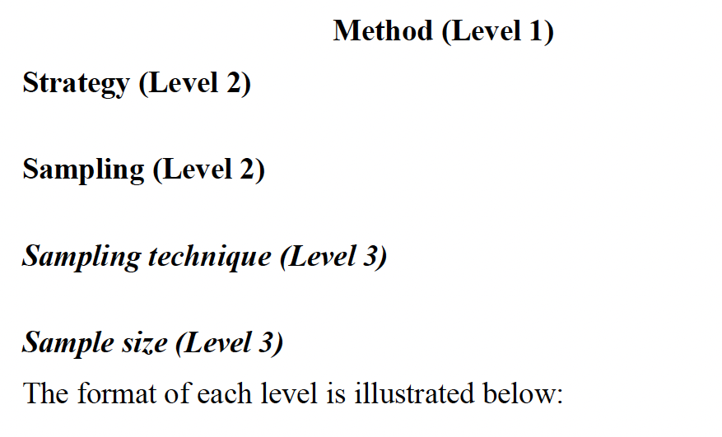
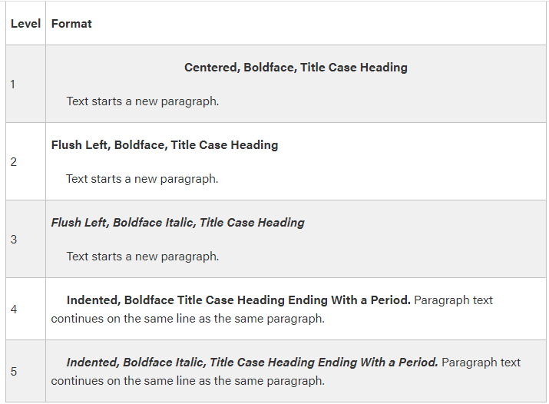
IR & FYP Document Format
Example headings & levels

Slide 36
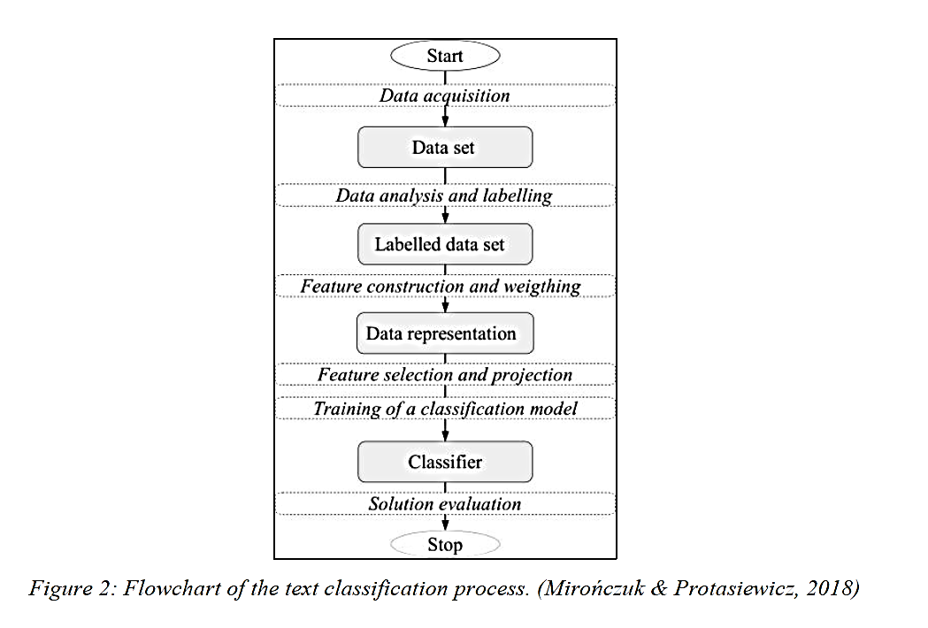
IR & FYP Document Format
Tables & Figures.
  Table Caption – Placed above the table.
  Figure Caption – Placed below the figure..

Slide 37
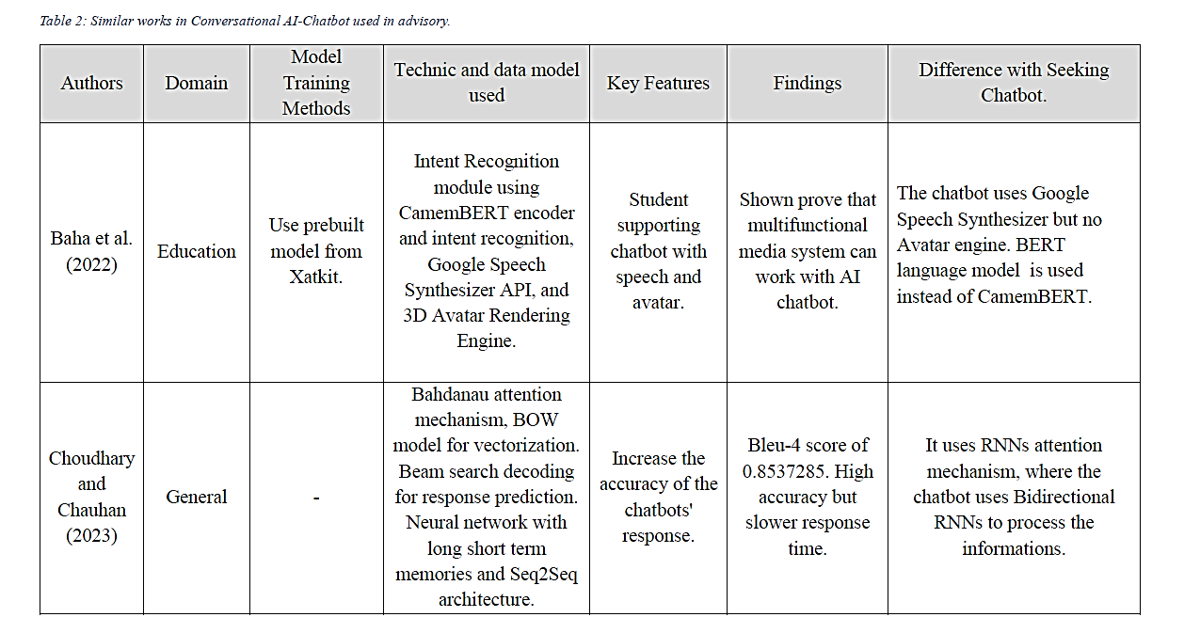
IR & FYP Document Format
Tables & Figures.
  Table Caption – Placed above the table.
  Figure Caption – Placed below the figure.

Slide 38
IR & FYP Document Format
Cover Page
  Make sure to use the correct cover page that are provided inside the TEAMS.

Slide 39
Q & A

